Slide 1
Implementation Report
Group 2B
Can AVCI
Deniz SİPAHİOĞLU
Ergün Batuhan KAYNAK
Esra Nur AYAZ

Slide 2
Index
Introduction
State of Implementation
Changes Made
Planned Changes
Incomplete Parts
Installation Guide

Slide 3
Introduction
If the expectations were fulfilled after implementation
Features explained in design and analysis reports
Some features included, some aren’t

Slide 4
State of Implementation
Navigate the menu with limited options
Play Game
Move on the map

Slide 5
Implemented Classes
User Interface Manager
Game Engine
Input Management
Map Management
Reader
Entity Management
Game Entities

Slide 6
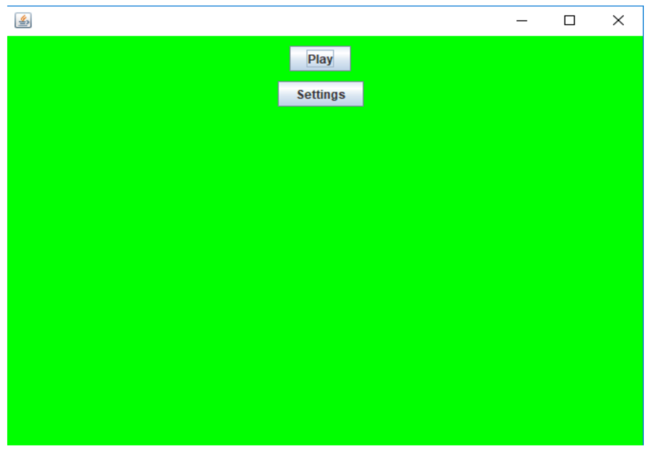
Screenshot of Main Menu

Slide 7
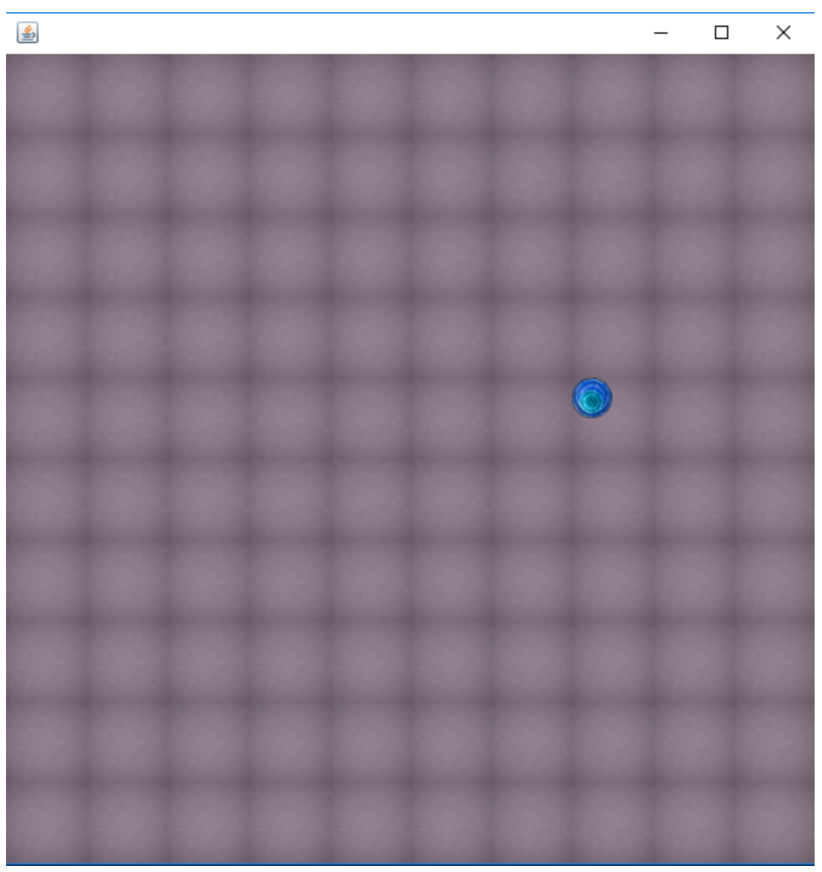
Screenshot of Game Panel

Slide 8
Changes Made
Wave audio files too large – mp3 files
Static and dynamic entities can’t be added using JPanel class – JLayeredPane
3 classes added - Layer, DynamicPanel, StaticPanel
Tile class used for movementSpeed
InputListener class
CellyManager before Entity Manager

Slide 9
Planned Changes
Input Manager – additional classes
Point class – transfer locations of Alive entities
Background music – threading
Room data read from text files – binding portals
Scaling problems

Slide 10
Incomplete Parts
Only a part of GameEntities implemented
Reader class incomplete (SoundReader)
EnemyAI

Slide 11
Installation Guide
JRE required
Will have jar support

